Slide 1
Online crime bureau
TOPIC
BY
Sumit Suresh Gole
Sameer Sanjay Ghogare

Slide 2
INTRDUCTION
The main aim of this system is to keep the records of criminal and maintain the information confidential. This system also helps to avoid loss of data. This system provides the daily updates of recent crimes and criminals. Helps to perform paperless work.This system gives citizen to register a complaint. And check the current status of case and cases which are pending and investigated.
This system has to module admin and citizen the citizen can register a complaint by filling the basic information. The admin can investigate the complaint also admin can manage the records of criminal in a system.admin can display the reports of complaint and the judgment of pending cases.

Slide 3
Scope of the work
The system ‘crime bureau’ will report crime that will be used for investigating the crime and criminal with different cases in police department. This system will manage the details of all the crime registered by the citizen. This system will simply maintain the records of criminal and investigate the crime as per criminal acts. This system also manage list about criminals as per their crimes and acts.

Slide 4
Objective of proposed system is as follows
Login for user and admin
Complaint registration.
Displaying complaint status.
Criminal records management

Slide 5
Operating environment
Software requirements:- Any Windows based operating system.
MS Access as the DBMS-for database.
Hardware requirements:- RAM 512 MB
2GB memory.

Slide 6
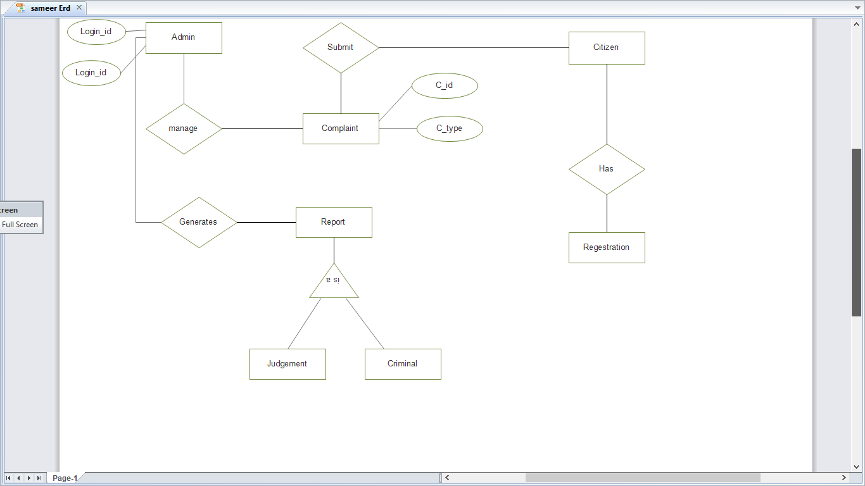
ERD

Slide 7
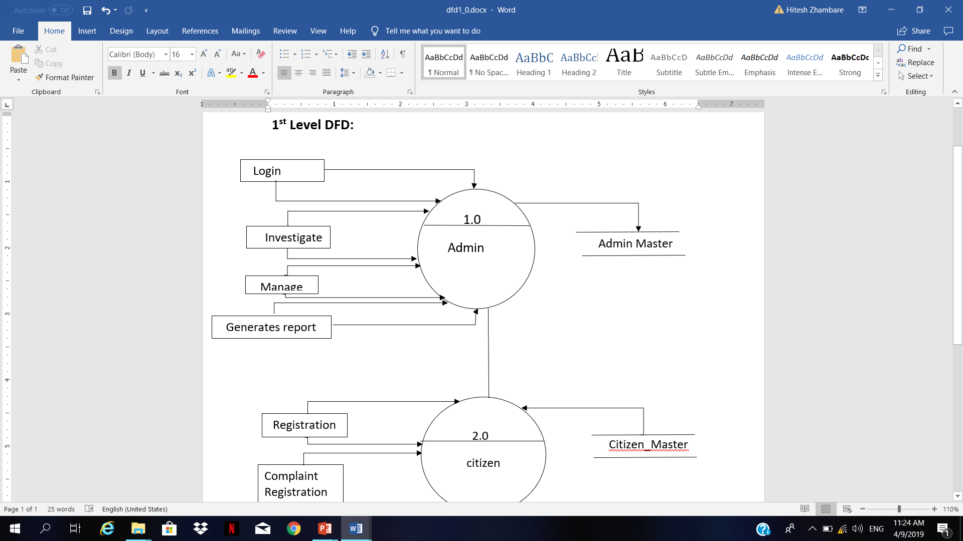
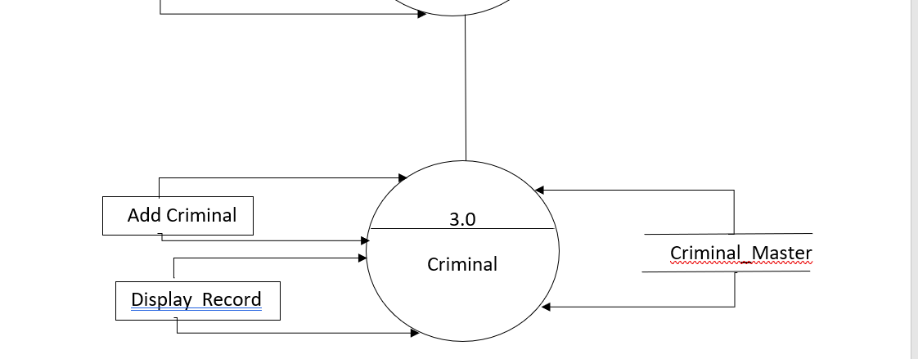
1st Level DFD

Slide 8
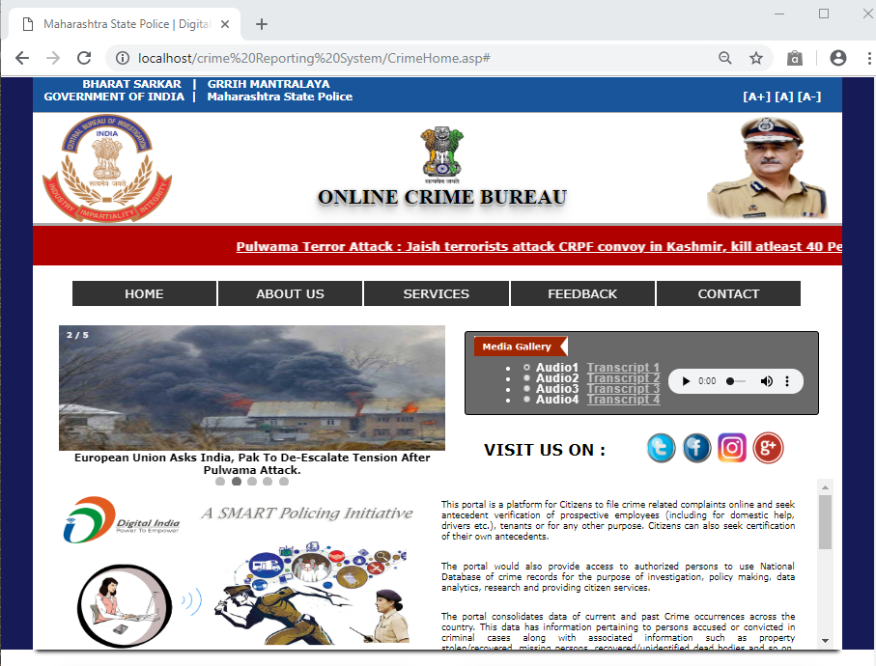
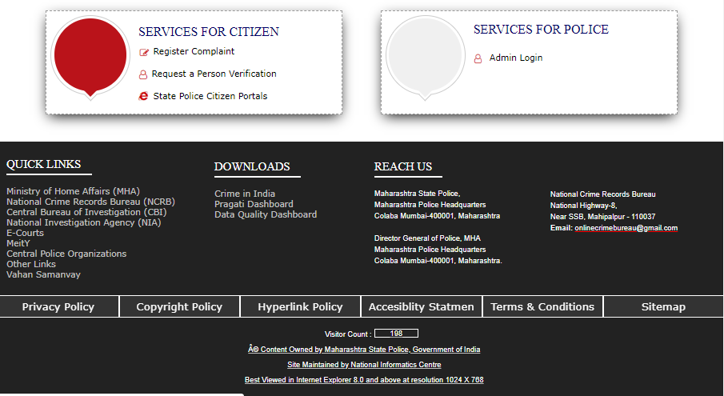
Home page

Slide 9
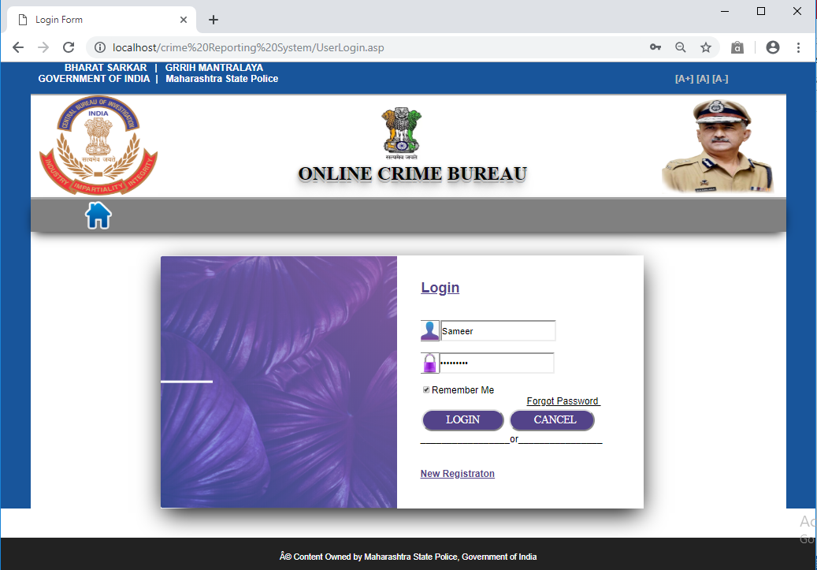
Login page

Slide 10
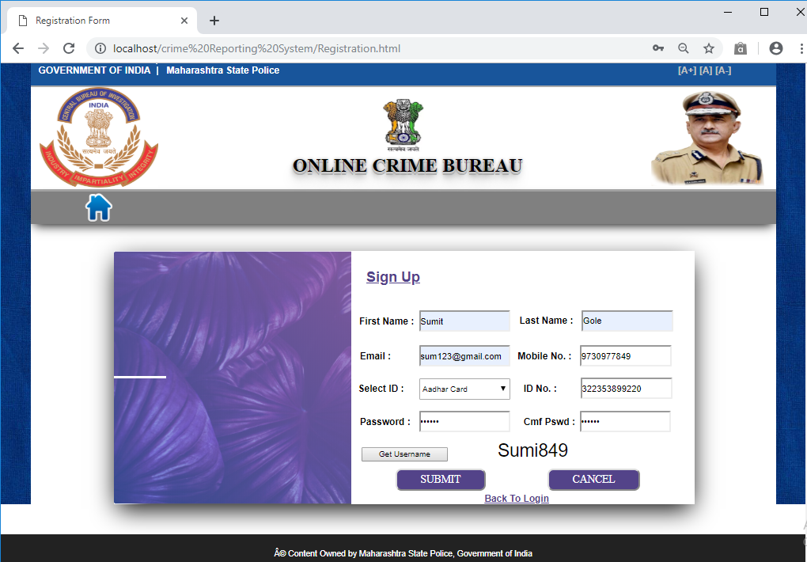
Registration page

Slide 11
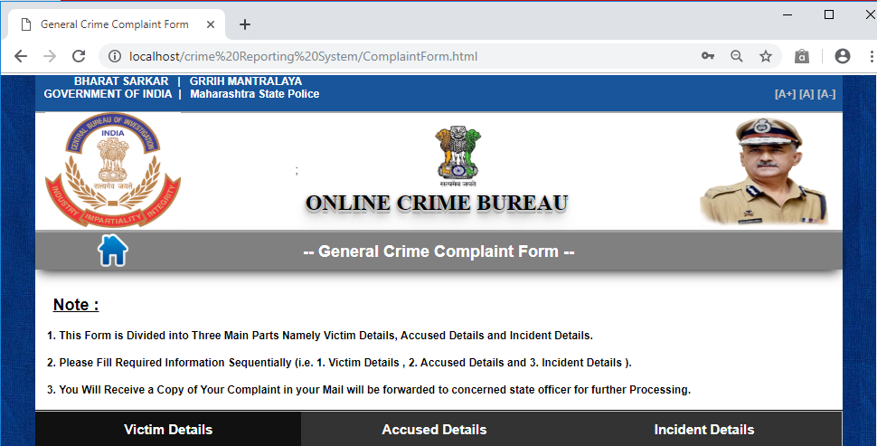
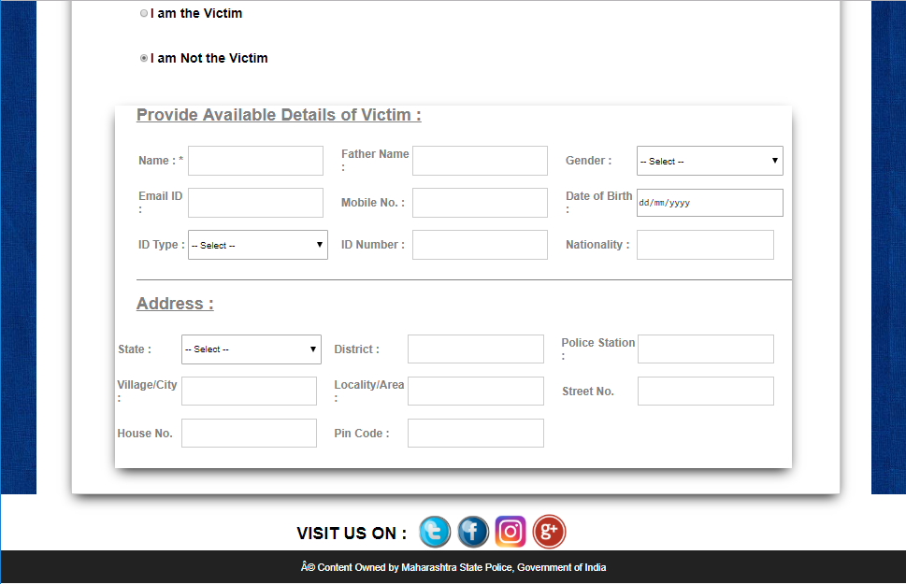
COMPLAINT FORM

Slide 12
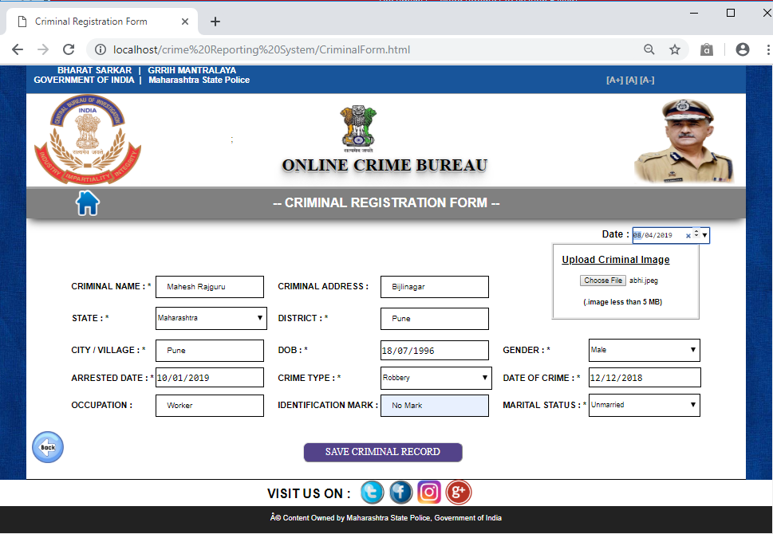
CRIMINAL REGISTRATION FORM

Slide 13
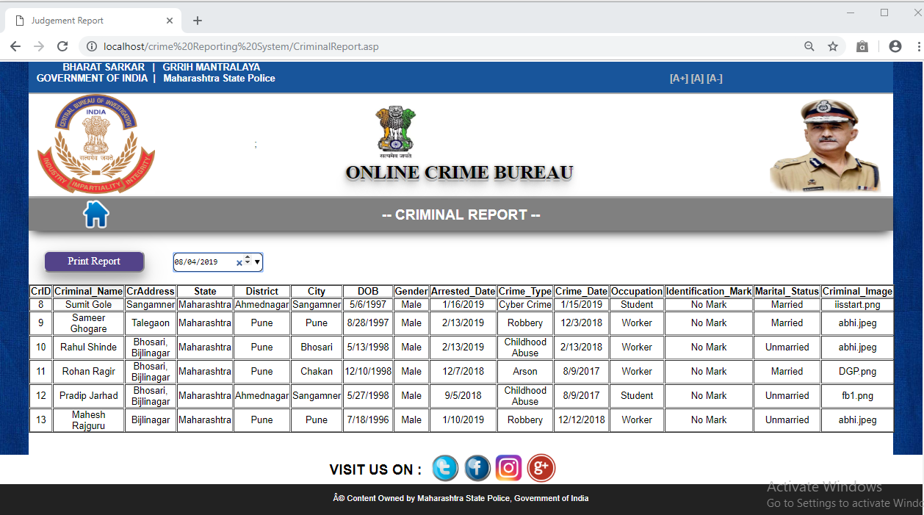
CRIMINAL REPORT

Slide 14
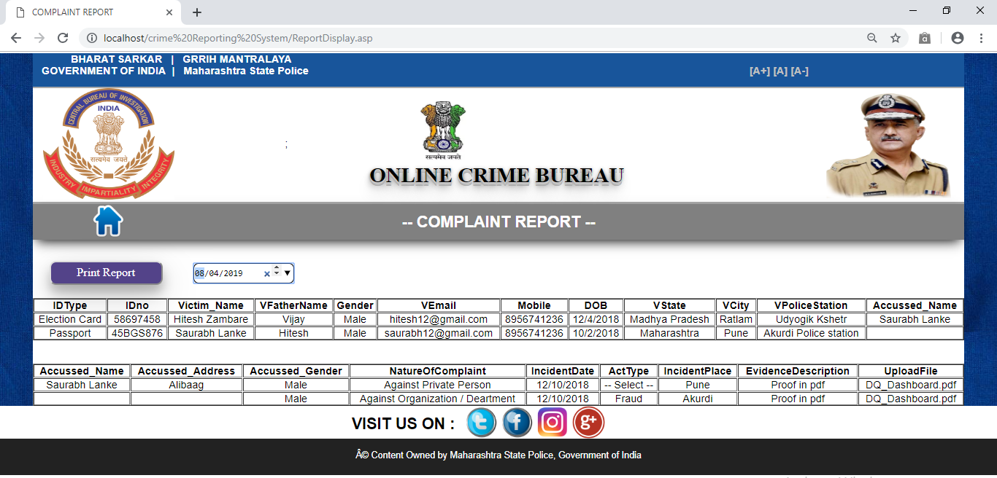
COMPLAINT REPORT

Slide 15
Thank you

